Slide 1
经典考题(一) -- calculator
224. Basic Calculator
227. Basic Calculator II 772. Basic Calculator III
你们的好朋友Eddie

Slide 2
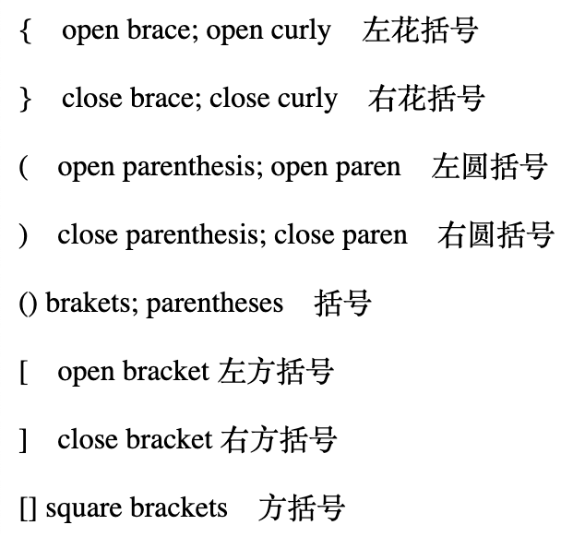
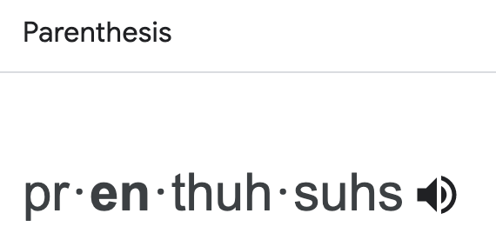
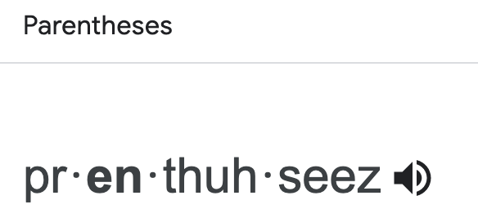
Concept & requirement
The end target of the three questions is to implement a calculator which has these functions:
It has +, -, *, / , parentheses and spaces.
The parentheses must be calculated first,and then * and / must be calculated second,and + and - must be calculated last.

Slide 3
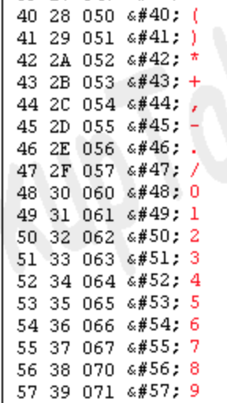
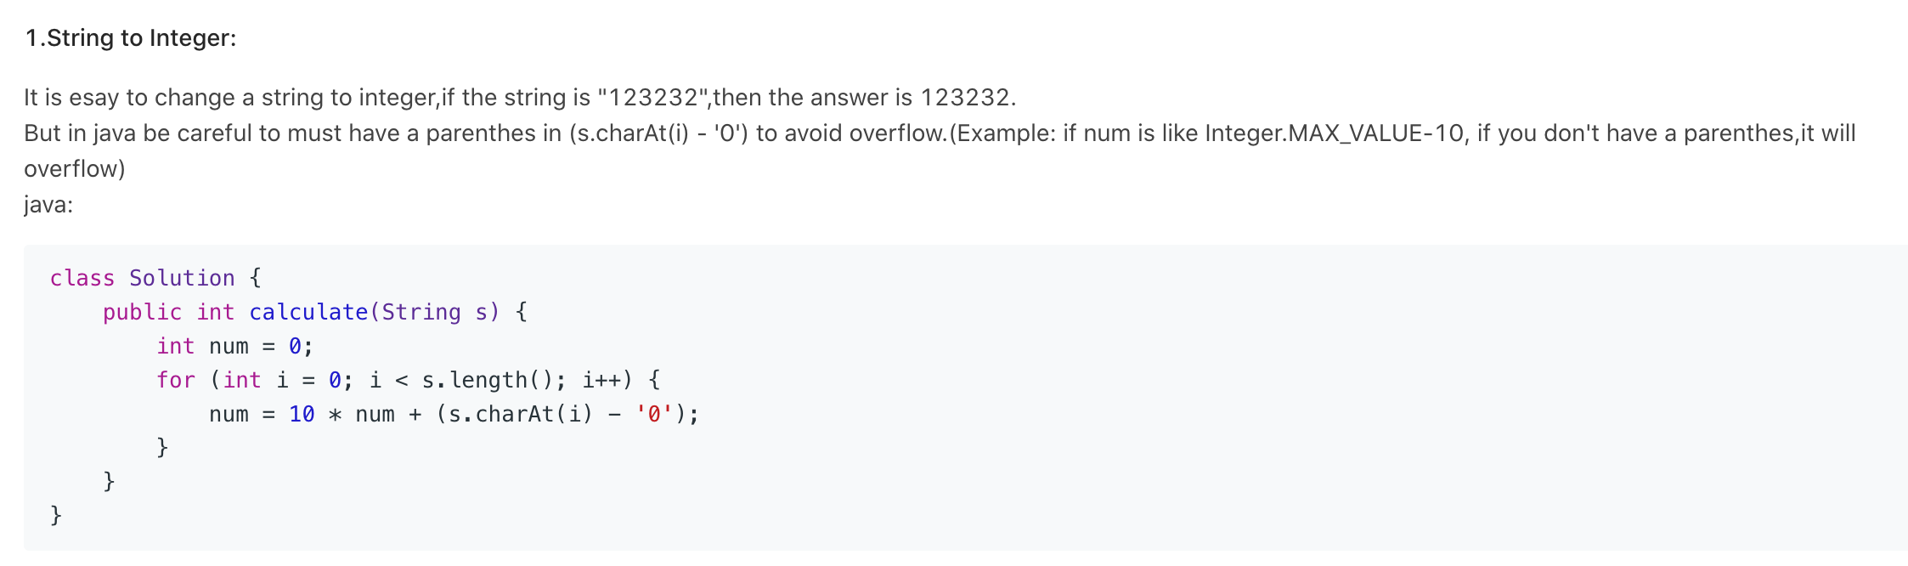
if only single number
How to check if it is a number?
char > ‘0’ due to +-*/ all has smaller ascii code
‘0’ <= char && char <= ‘9’
Character.isDigit()

Slide 4
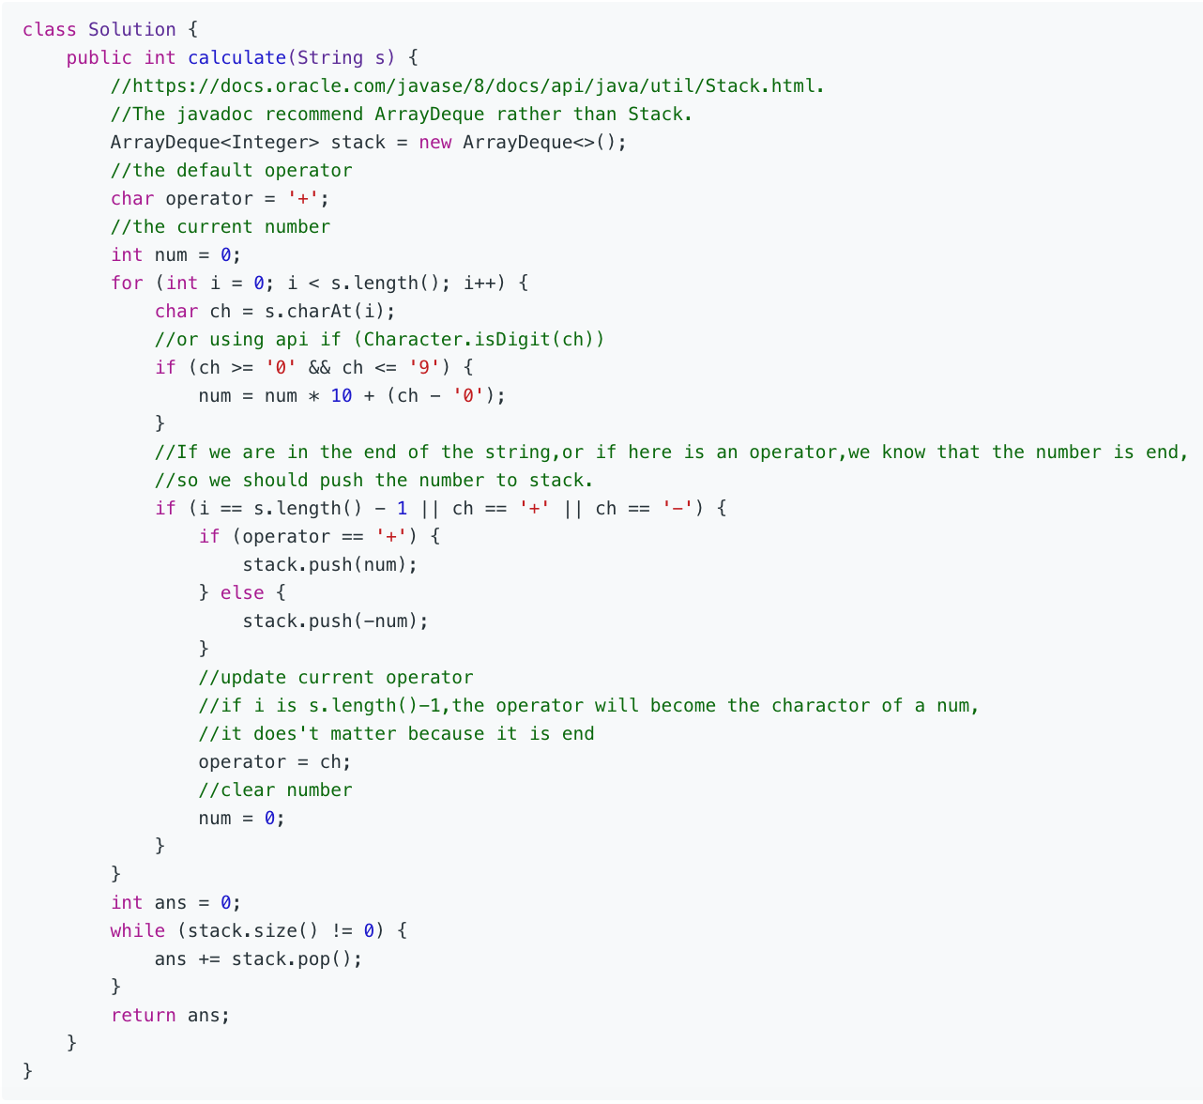
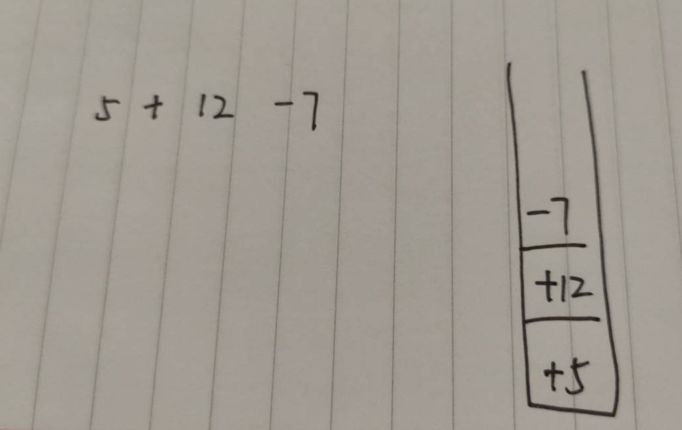
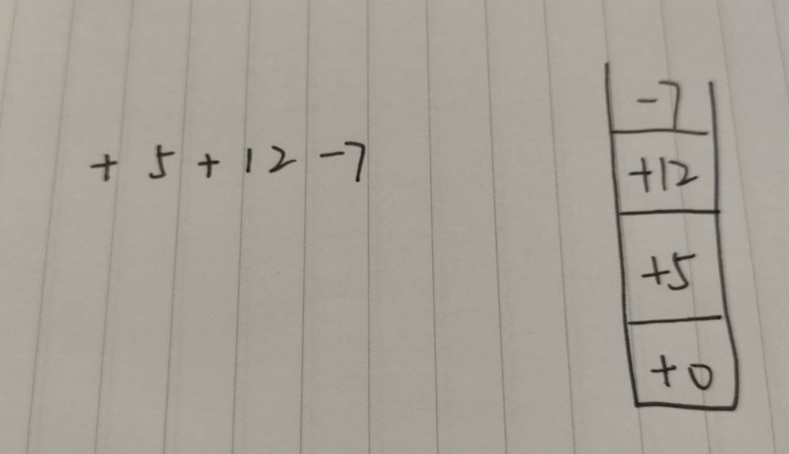
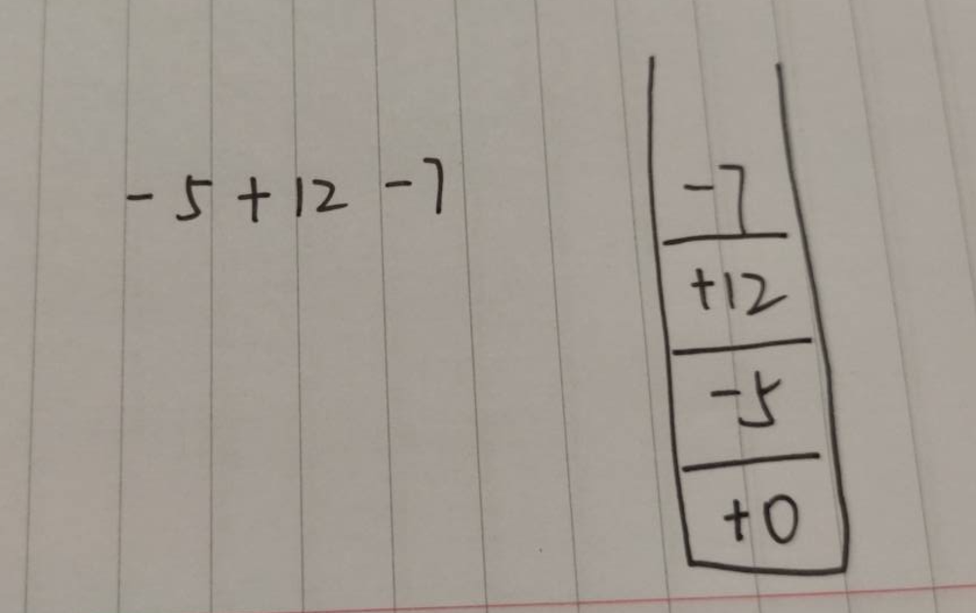
if only have ‘ + ’ ‘ - ’

Slide 5
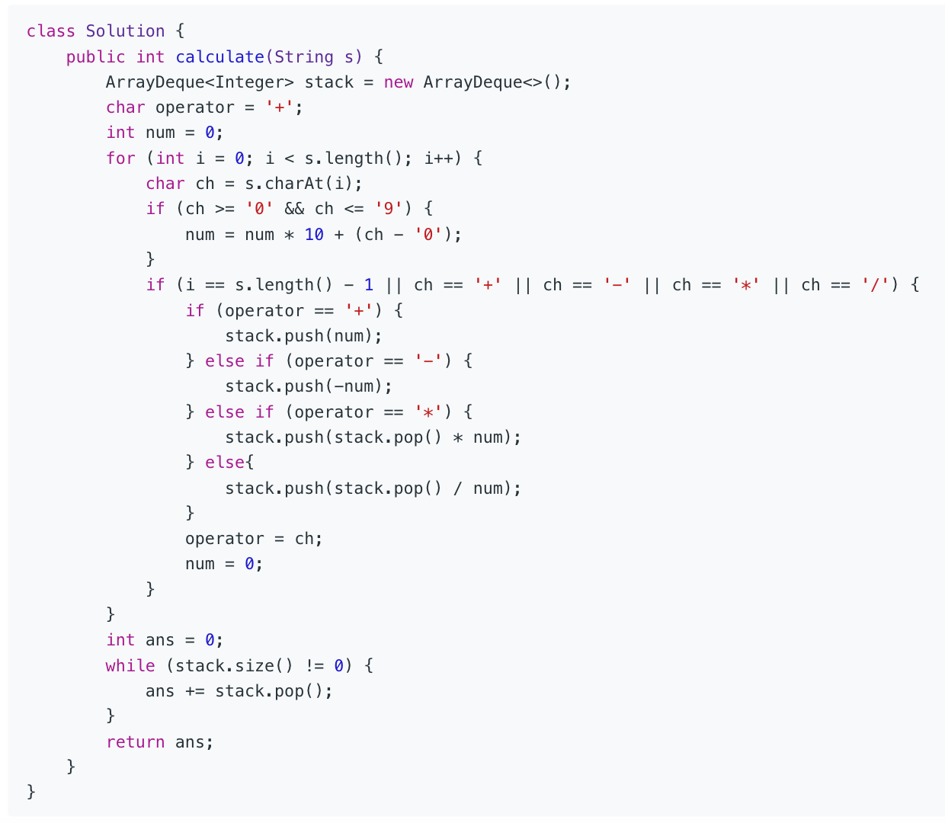
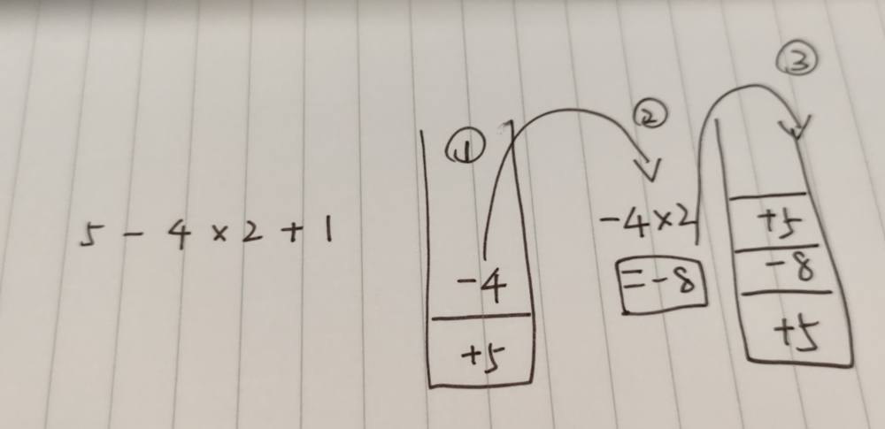
if have + - * /
这里第一次的pop出来的是-4，第二次遇到+号才去处理之前的4 * 2
-4 * 2是在 遇到 + 号的时候才被pop出来处理的。
stack.pop() = -4
num = 2;
ch = ‘+’
operator = ‘*’

Slide 6
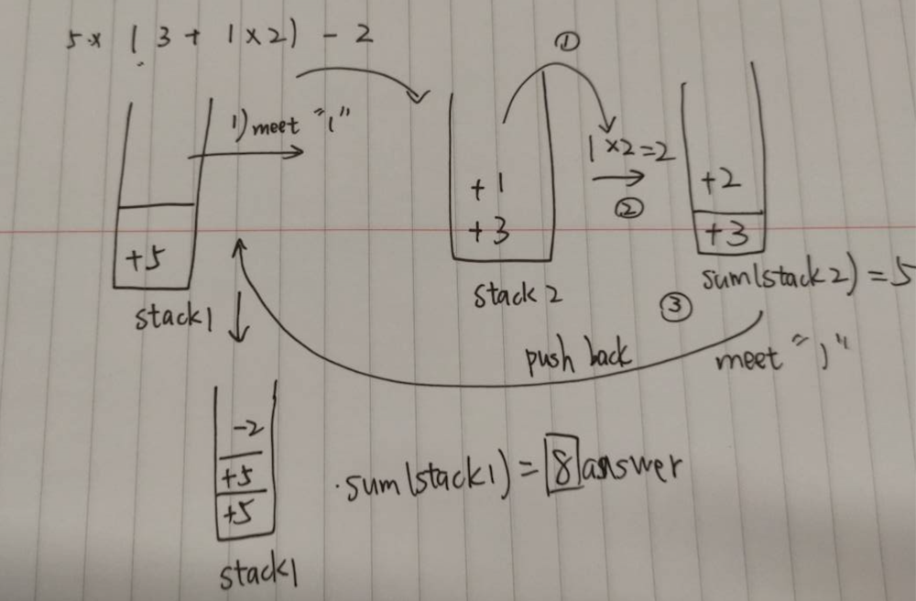
if 再加上括号 除了+-*/
When there are parentheses, the parentheses must be calculated first. So we can use recursion to deal with it.When we meet (,we go into a recursion to deal with it ,when we meet ) we jump out of the recursion.
Look at the picture,when we meet (, we run into another recursion to deal with 3+1*2, when we meet ), we jump out of it.Look at the code to help you understand.

Slide 7
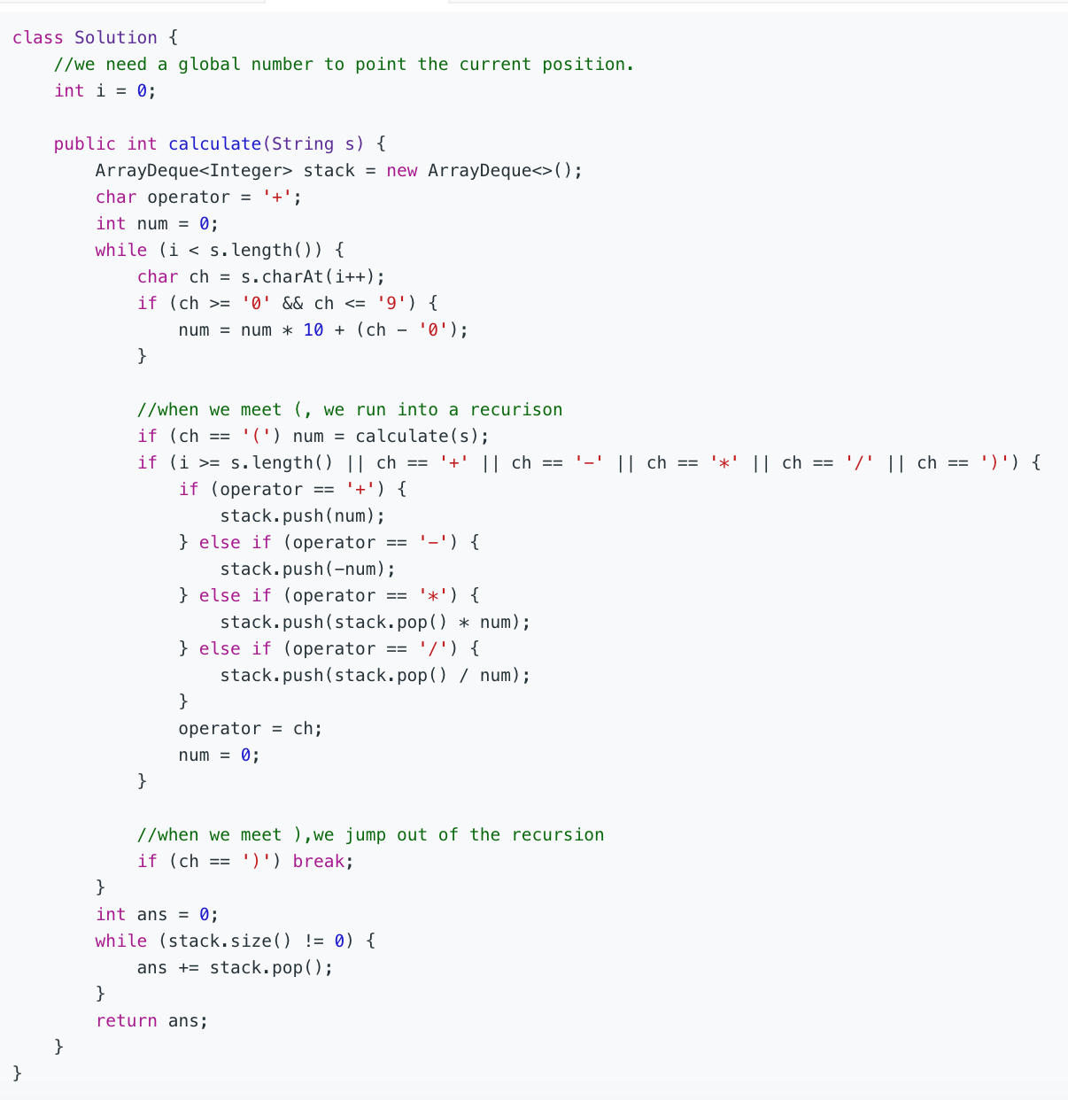

Slide 8
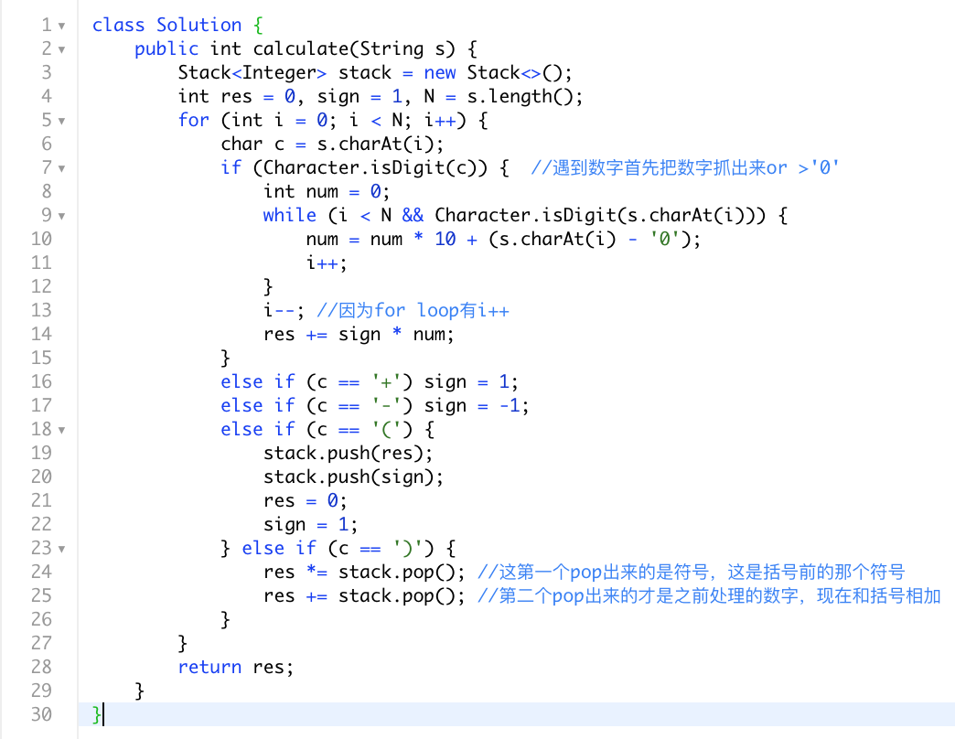
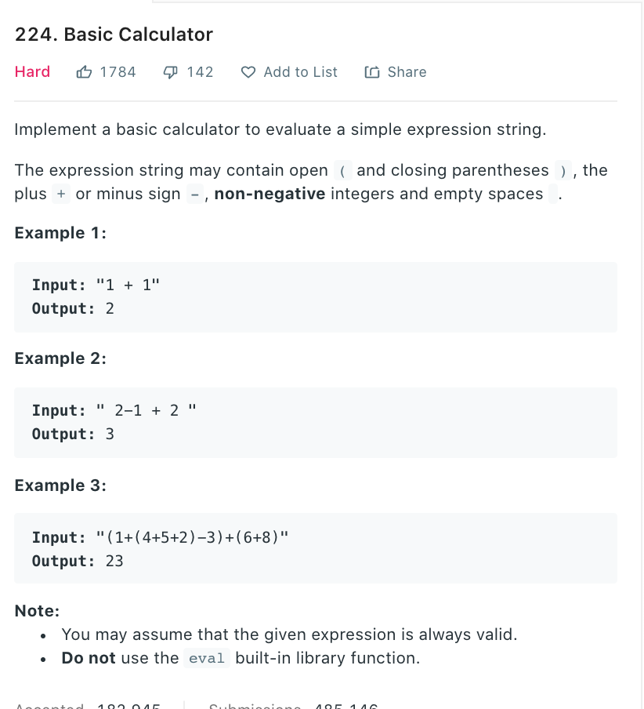
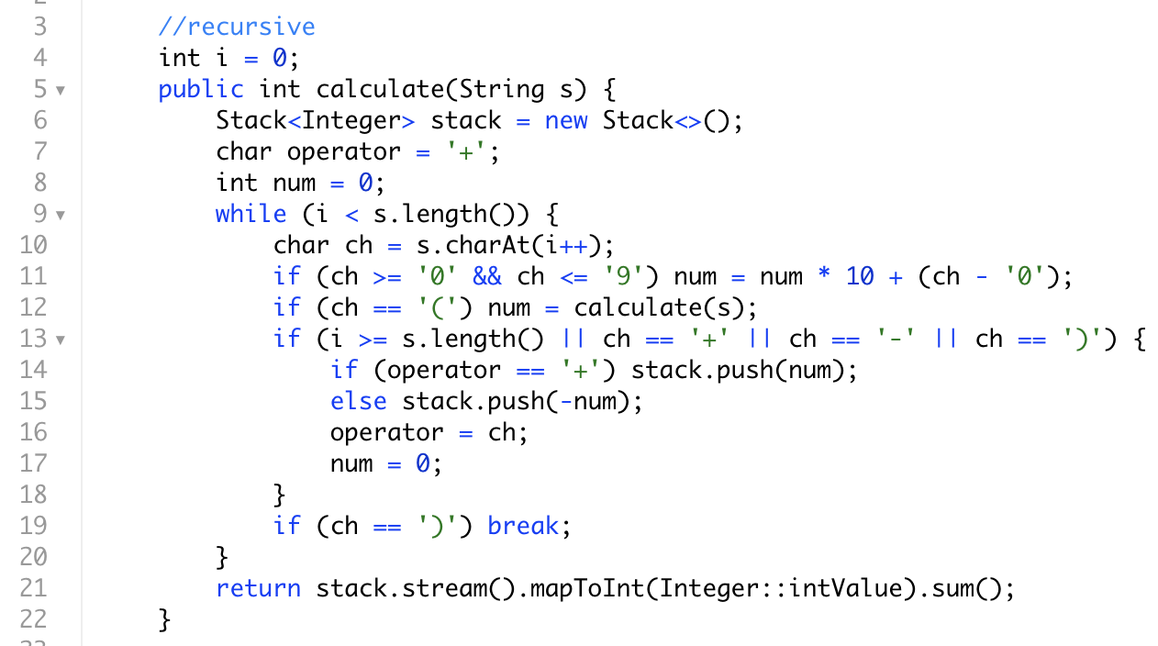
iterative
pure stack
stack with recursive help

Slide 9
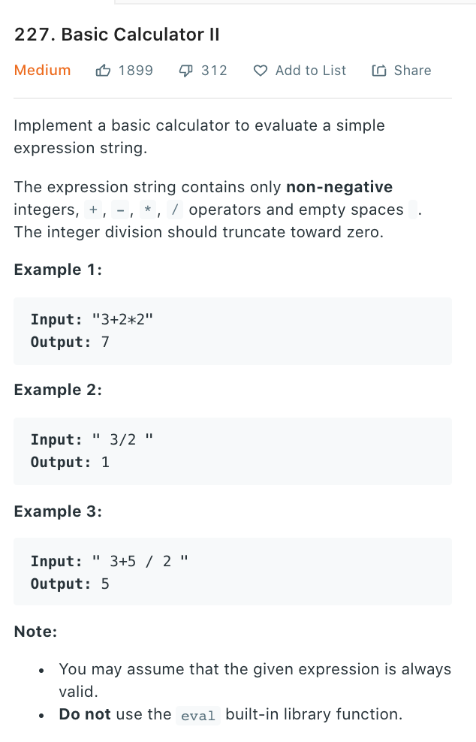
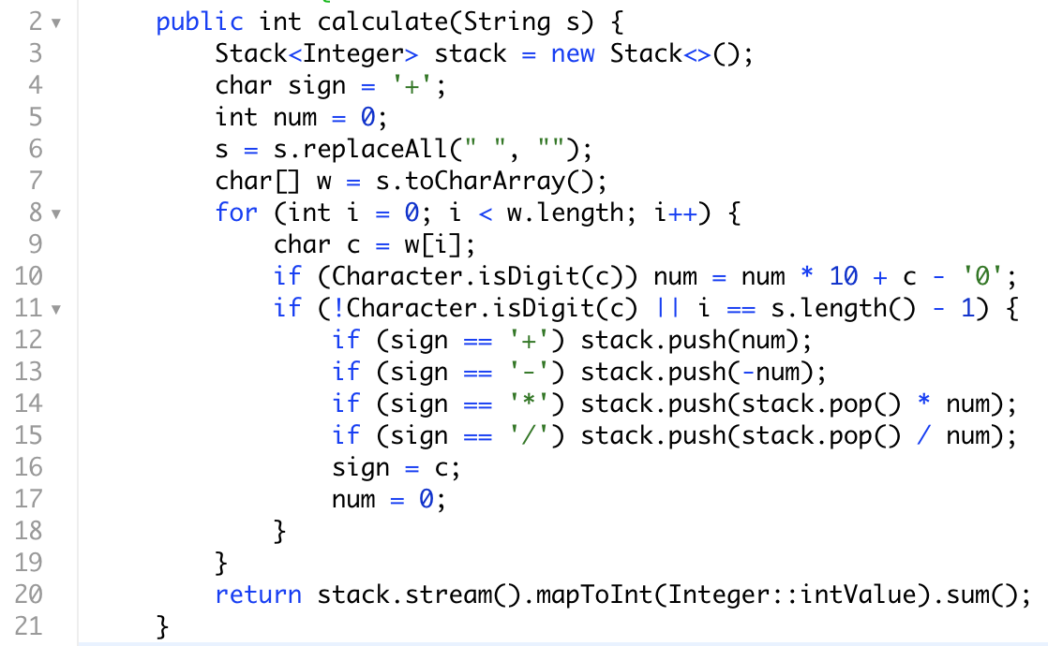
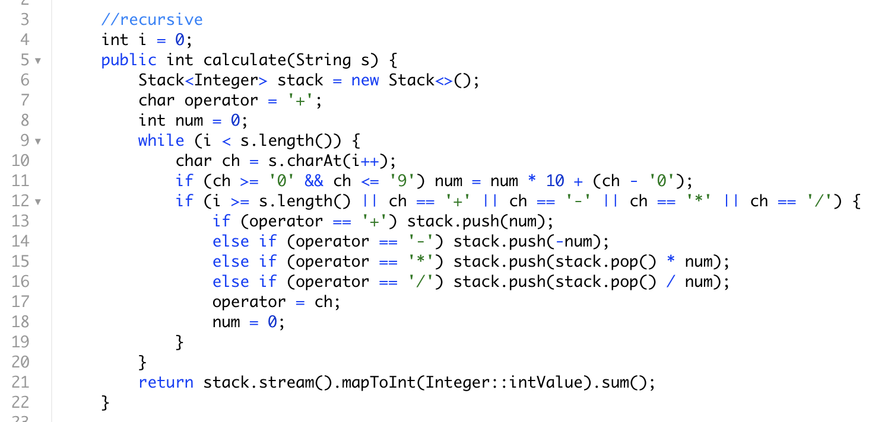
没有括号
没区别
二者都很直接
iterative
infor for loop
using template

Slide 10
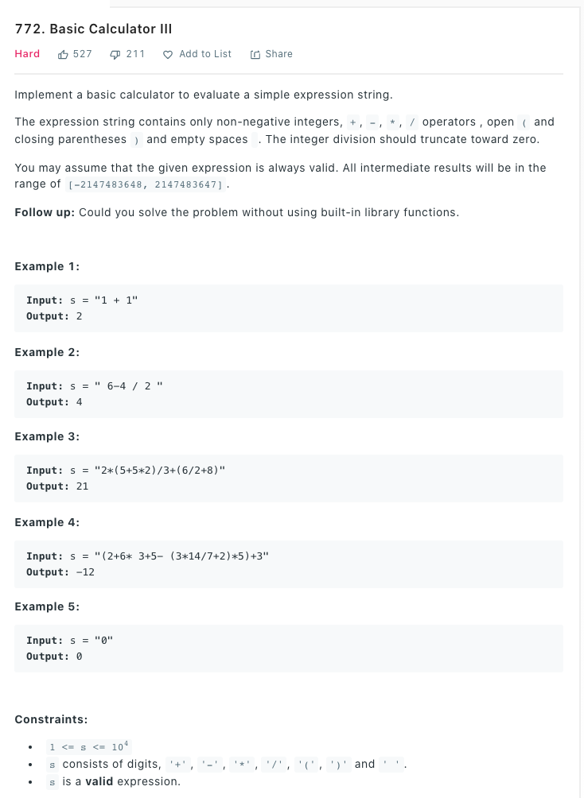
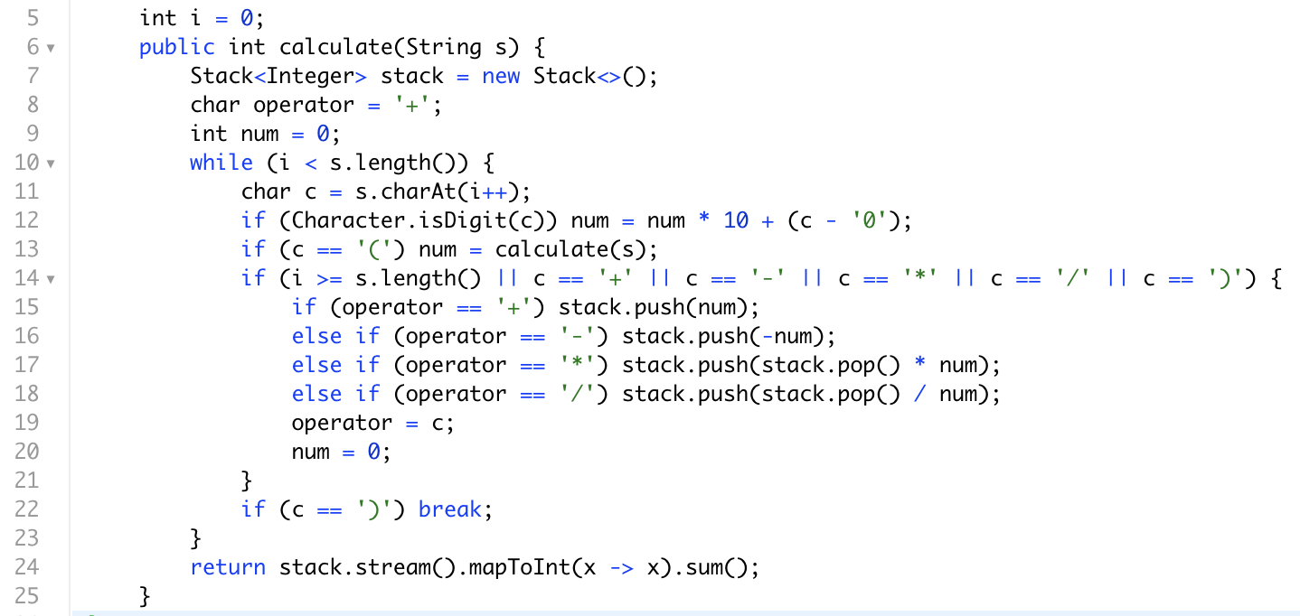
此题推荐使用template (stack & recursive)

Slide 11
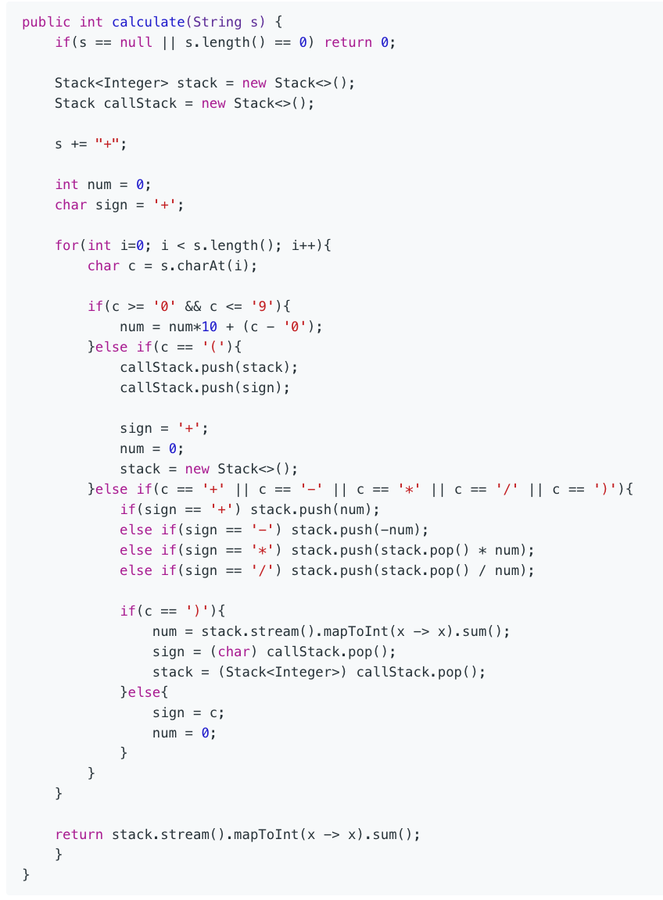
not recommend, but you can still use pure iterative way for calculator-3

Slide 12
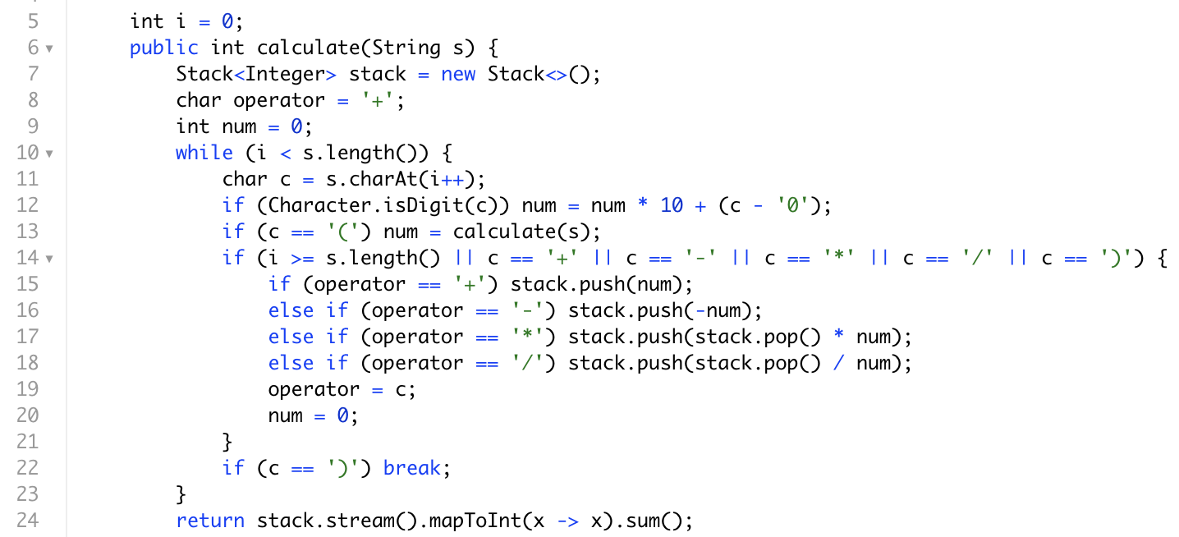
Summary:
calculator use stack to deal with operator +-*/
calculator use recursive to deal with ‘(‘ ‘)’
spaces can be emit with string.replaceAll(“ “, “”); or just ignore it outside of “if”
java can use Character.isDigit() or ‘0’ <= char <= ‘9’ to check if it’s a number
stack sum can use Java8 stream() or normal for loop
recommend to use stack & recursive together, template:
more thing:
in an interview, they could only give you number and you need to add operator and parentheses to get possible result
这里的if不是elseif因为两个if都有可能被运行，比如结尾为数字，我们就需要再进stack

Slide 13
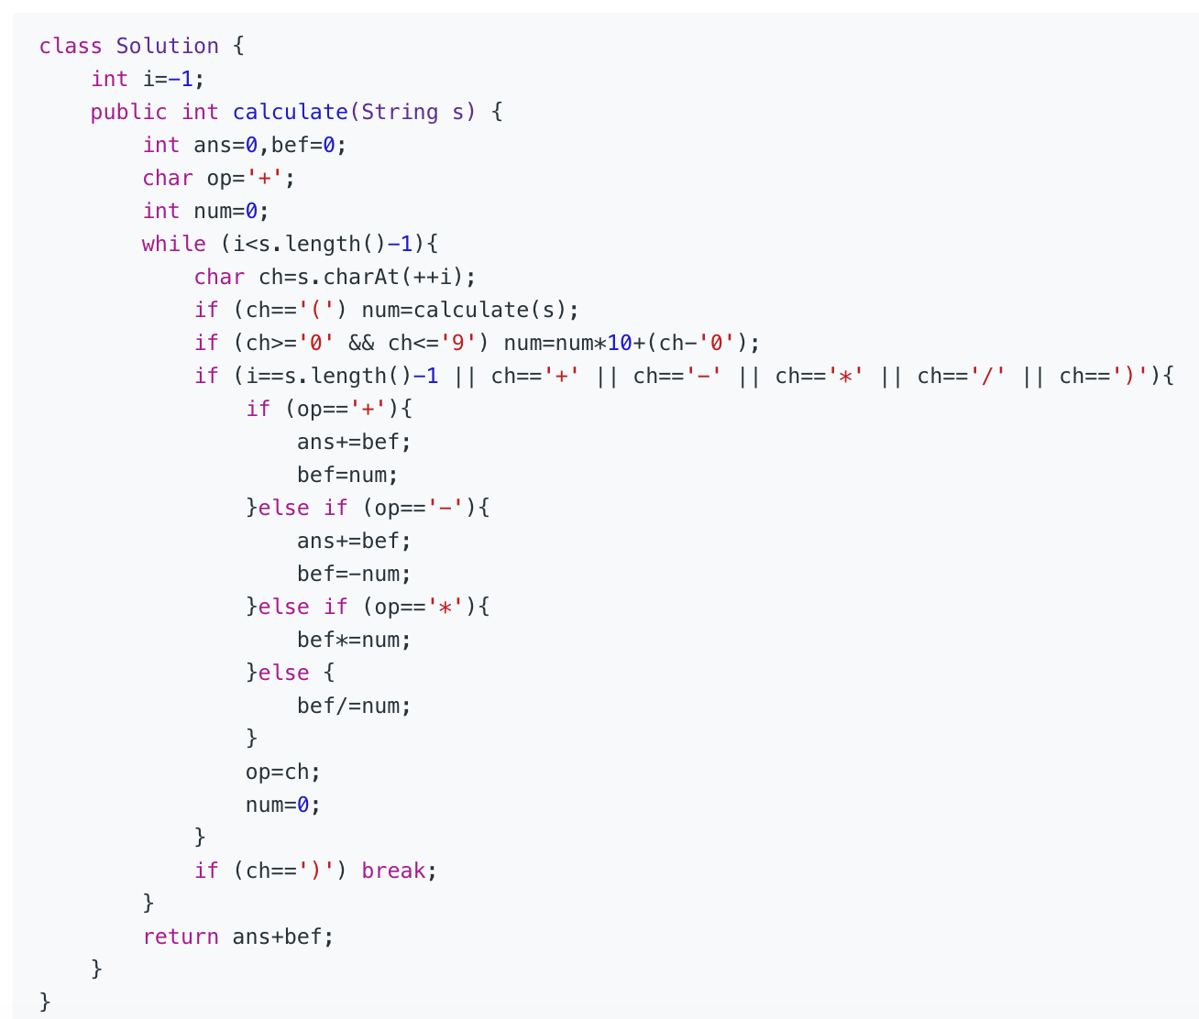
if you want to optimize space to O(1)
It is easy to find that we only need the top number and the next of the top number in the stack,so we can avoid using stack. Look at the final version of the O(1) calculator:

